Slide 1

Java
Java GC
Александр Помосов

Slide 2
Reminder
Отметьтесь на портале
‹#›

Slide 3
Reminder
Обновите репозиторий
‹#›

Slide 4
Agenda
Heap, Object layout
Garbage Collectors
Performance
Interview questions
‹#›
Notes:
‹#›

Slide 5
Agenda
Heap, Object layout
Garbage Collectors
Performance
Interview questions
‹#›
Notes:
‹#›

Slide 6

HotSpot JVM
The following material is mostly JVM-specific
We will look at HotSpot implementation, as it is De facto standard for servers
http://www.oracle.com/technetwork/articles/javase/index-jsp-136373.html
Set apart Dalvik, ART (Android JVM)
‹#›

Slide 7

Structure of java process
Structure of java process is defined by Java Virtual Machine Specification (JVMS)
https://docs.oracle.com/javase/specs/jvms/se7/html/jvms-2.html#jvms-2.5.3
Method area is mostly constant-size
The most dynamic (and bigger) part is Heap
Heap space
Method area
All the objects, created in program
are stored here
Heap structure depends on chosen Garbage Collector (GC)
Metaspace
Runtime Constant Pool
Field and Method Data
Code for Methods and Constructors
‹#›

Slide 8
Object allocation
… So objects are allocated on heap
Q: Can objects (e.g. local for method) be allocated on stack?
A: Not specified. But currently not. For curious:
http://dev.cheremin.info/2016/02/stack-allocation-vs-scalar-replacement.html
Q: Is that this heap? https://en.wikipedia.org/wiki/Heap_(data_structure)
A: No! Heap has complex structure which is depends on chosen GC
Q: So, how is Object represented in heap?
A: ...
‹#›

Slide 9
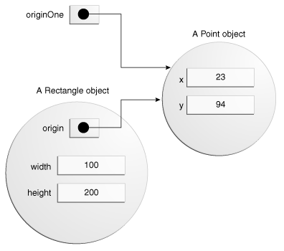
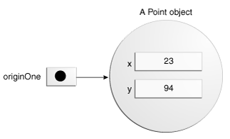
Object allocation - example
https://docs.oracle.com/javase/tutorial/java/javaOO/objectcreation.html
Meanwhile somewhere in heap... Meanwhile somewhere in heap...
Point originOne = new Point(23,94);
Rectangle rectOne = new Rectangle(originOne, 100, 200);
‹#›

Slide 10
Game: Guess size
By size we mean footprint, i.e. total size of reference + shadow (retained) size (all the referenced objects and primitives recursively)
retained size - number of bytes, that will be freed if you remove object
What is the footprint of:
int x = 10;
new Integer(10);
new Long(10);
new Integer[1000];
new ArrayList<Integer>(1000);
new LinkedList<Integer>(1000);
new HashSet<Integer>(1000);
Warning: Not an easy game!
‹#›

Slide 11

Object layout
Layout - how objects are represented in heap
“The Java Virtual Machine does not mandate any particular internal structure for objects”
https://docs.oracle.com/javase/specs/jvms/se8/html/jvms-2.html#jvms-2.7
We will look at HotSpot implementation (Java 8)
We need to go deeper...
‹#›

Slide 12
Object layout details
Object layout is:
JVM specific
bitness dependent
tunable by JVM flags
Example for x64 system with
-XX:+UseCompressedOops (default)
for heaps less than 32GiB object reference is 32 bit
else 64 bit
http://docs.oracle.com/javase/7/docs/technotes/guides/vm/performance-enhancements-7.html#compressedOop
4 bytes
Class pointer
12
bytes
Object
header
mark word
(various flags)
8 bytes
field references
fields
...
alignment
Object is aligned by 8 bytes
‹#›

Slide 13

jol
Good tool for object layout analysis - Java Object Layout
http://openjdk.java.net/projects/code-tools/jol/
@see jol.samples.JOLSample_01_Basic
@see jol.samples.JOLSample_02_Alignment
@see jol.samples.JOLSample_03_Packing
@see jol.GuessSize
<dependency> <groupId>org.openjdk.jol</groupId> <artifactId>jol-core</artifactId> <version>put-the-version-here</version> </dependency>
‹#›

Slide 14
Agenda
Heap, Object layout
Garbage Collectors
Performance
Interview questions
‹#›
Notes:
‹#›

Slide 15
Garbage Collector
Q: Why we need Garbage Collector
A: To remove garbage, obviously
Q: What is garbage?
A: Objects that are no longer referenced
Q: Does cyclic references stall objects in heap forever
A: No. Object is garbage if it can not be reached from GC Roots
Q: What are GC Roots?
A: … (proceed reading)
‹#›

Slide 16
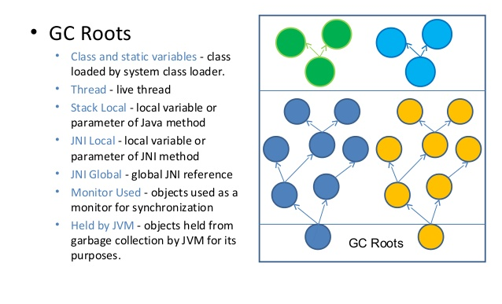
GC Roots and Garbage
‹#›

Slide 17
Problem 1. Memory Leaks
GC behaves as expected unless you deal with low-level details via Unsafe or JNI.
Object, that is used somehow will never be deleted
The opposite problem is memory leak - when some object is no longer used, but still not counted as garbage. This is much common, but not as common as in c++.
‹#›

Slide 18

Memory Leak Sources
Thank to GC it is much harder to introduce memory leak in java than, e.g. in C++
ObjectInputStream and ObjectOutputStream call reset() to flush inner object caches
Threads (every thread has stack) use ThreadPools to control and reuse Threads
non-static inner classes instance of non-static inner class has reference to instance of enclosing class
thread-locals Thread-locals live while thread live unless explicitly cleared
Memory leaks examples:
http://stackoverflow.com/questions/6470651/creating-a-memory-leak-with-java
https://habrahabr.ru/post/132500/
(except String.substring() - this is not the case anymore)
‹#›

Slide 19
Problem 2. GC Performance
All GCs in HotSpot are ‘Stop-the-world’
i.e. there are moments when all the application threads are stopped and GC is working.
Different GCs implement different strategies to reduce pauses. Some even give guarantees of maximum pause time.
There is an attempt to implement ‘ultra-low pause’ GC
http://openjdk.java.net/projects/shenandoah/ (not production-ready)
There are JVM implementations where GC is pauseless:
https://www.azul.com/products/zing/ (proprietary)
‹#›

Slide 20

GC Tuning Capabilities
GC is not controlled directly (there is no legal way to force GC)
but is managed by JVM
System.gc(); // this is just recomendation
Runtime.gc();// this is just recomendation
Java provides mechanisms to tune GC via JVM parameters
You can choose:
Garbage collector implementation
Several Garbage collector parameters
‹#›

Slide 21
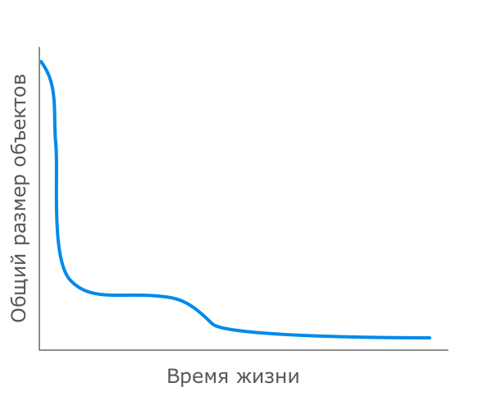
Idea behind GC Implementations
New object
most likely die immediately
If object survives,
it will probably
live long
Most objects
live fast, die young
‹#›

Slide 22
‘Generations’ Idea
We can divide objects into
young generation (newly created objects) here we achieve high throughput - every GC removes almost all objects
survivor objects that survived several GCs
old generation (objects that survived many garbage collections) here we achieve memory efficiency - GCs are rare, memory is not fragmented
This idea is used in every GC implementation in HotSpot. It works!
‹#›

Slide 23
Available Garbage Collectors
Serial (последовательный) simple, suitable for single-threaded applications with small heap
Parallel (параллельный) same as serial, but adds parallelism to some GC stages and is able to adapt to given performance goals
Concurrent Mark Sweep (CMS) minimize maximum pause time, is suitable for large heaps
Garbage-First (G1) In perspective will replace CMS. Has different heap structure. Suitable for highly concurrent applications with big heaps
https://habrahabr.ru/post/269621/ https://habrahabr.ru/post/269707/ https://habrahabr.ru/post/269863/
‹#›

Slide 24
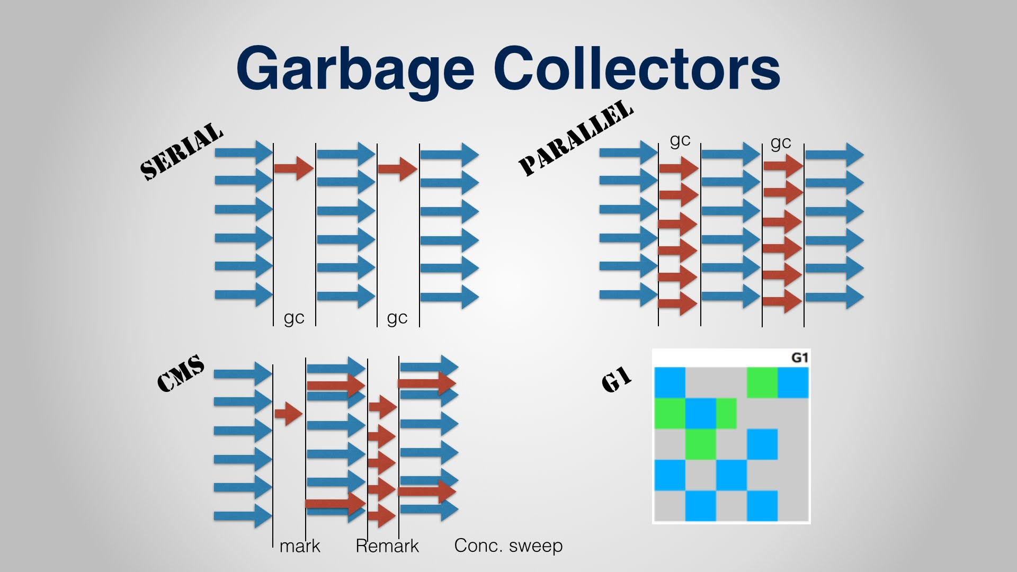
Available Garbage Collectors
‹#›

Slide 25
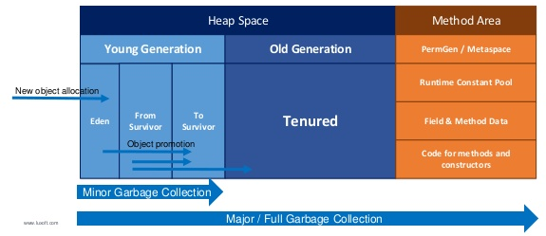
Serial/Parrallel/CMS Heap Structure
Exact heap structure is defined by chosen GC. For all standard HotSpot GC except G1GC (Serial, Parallel, Concurrent Mark Sweep) heap structure is as following:
‹#›

Slide 26
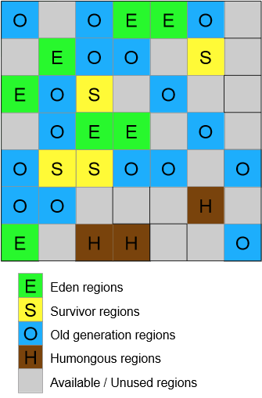
G1GC
divides heap into regions that can act as Eden, Survival or Old generation regions and it can change role dynamically
http://www.oracle.com/technetwork/java/javase/tech/g1-intro-jsp-135488.html http://www.oracle.com/technetwork/articles/java/g1gc-1984535.html https://docs.oracle.com/javase/8/docs/technotes/guides/vm/gctuning/g1_gc.html
‹#›

Slide 27

Trace objects with JOL
New object allocation
@see jol.samples.JOLSample_17_Allocation
Promotion
@see jol.samples.JOLSample_19_Promotion
‹#›

Slide 28
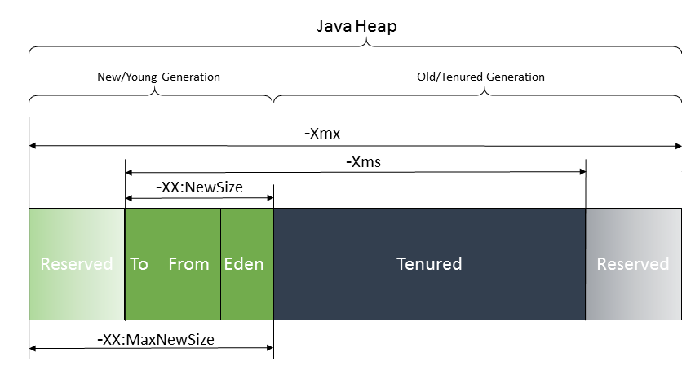
Sizing generations
You can control sizes of generations and heap by JVM parameters
‹#›

Slide 29
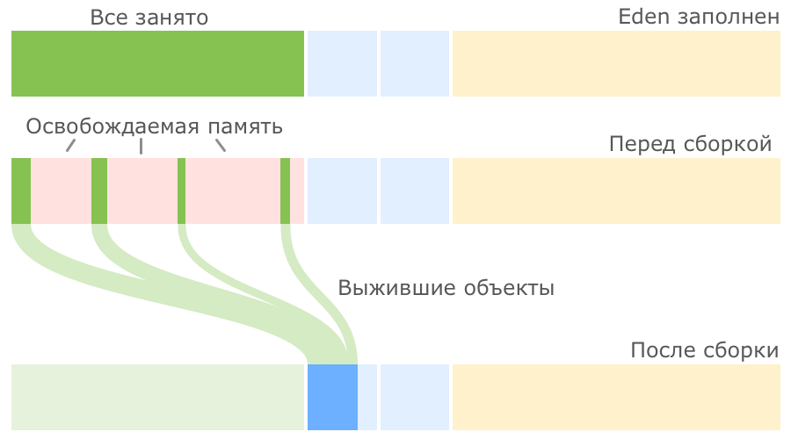
Concurrent Mark Sweep (CMS)
‹#›

Slide 30

CMS GC to Survival
‹#›

Slide 31

CMS Copy Survival
‹#›

Slide 32

CMS Copy to Tenured and Compact
‹#›

Slide 33
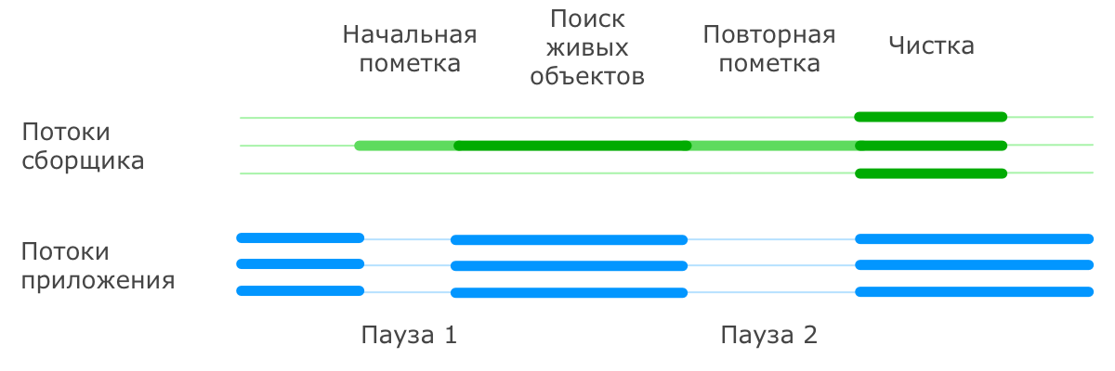
CMS Tenured GC
TODO
‹#›

Slide 34
GC choosing guidelines
If the application has a small data set (up to approximately 100 MB), then select the serial collector with the option -XX:+UseSerialGC.
If the application will be run on a single processor and there are no pause time requirements, then let the VM select the collector, or select the serial collector with the option -XX:+UseSerialGC.
If (a) peak application performance is the first priority and (b) there are no pause time requirements or pauses of 1 second or longer are acceptable, then let the VM select the collector, or select the parallel collector with -XX:+UseParallelGC.
If response time is more important than overall throughput and garbage collection pauses must be kept shorter than approximately 1 second, then select the concurrent collector with -XX:+UseConcMarkSweepGC or -XX:+UseG1GC
‹#›

Slide 35
Heap sizing guidelines
The following are general guidelines for server applications:
First decide the maximum heap size you can afford to give the virtual machine. Then plot your performance metric against young generation sizes to find the best setting. Note that the maximum heap size should always be smaller than the amount of memory installed on the machine to avoid excessive page faults and thrashing.
If the total heap size is fixed, then increasing the young generation size requires reducing the tenured generation size. Keep the tenured generation large enough to hold all the live data used by the application at any given time, plus some amount of slack space (10 to 20% or more).
Subject to the previously stated constraint on the tenured generation:
Grant plenty of memory to the young generation.
Increase the young generation size as you increase the number of processors, because allocation can be parallelized.
‹#›

Slide 36
GC Tuning
First we must decide tuning goal, which is specific for application. Common tuning goals are:
Throughput is the percentage of total time not spent in garbage collection considered over long periods of time
Maximum Pause Time are the times when an application appears unresponsive because garbage collection is occurring
https://docs.oracle.com/javase/8/docs/technotes/guides/vm/gctuning/toc.html
‹#›

Slide 37
GC Logging
-Xloggc:filename causes information about the heap and garbage collection to be writed at each collection to file
[GC 325407K->83000K(776768K), 0.2300771 secs] [Full GC 267628K->83769K(776768K), 1.8479984 secs]
-XX:+PrintGCDetails using the serial garbage collector is shown here
[GC [DefNew: 64575K->959K(64576K), 0.0457646 secs] 196016K->133633K(261184K), 0.0459067 secs]
-XX:+PrintGCTimeStamps adds a time stamp at the start of each collection
111.042: [GC 111.042: [DefNew: 8128K->8128K(8128K), 0.0000505 secs]111.042: [Tenured: 18154K->2311K(24576K), 0.1290354 secs] 26282K->2311K(32704K), 0.1293306 secs]
‹#›

Slide 38
Essential JVM parameters
The following options are essential. Whenever you crash with Out Of Memory Error, you have a Heap Dump:
-XX:+HeapDumpOnOutOfMemoryError
-XX:HeapDumpPath=<path to dump>`date`.hprof
-server
‹#›

Slide 39
How to get heap dump
jmap -dump:format=b,file=dump.bin <pid>
‹#›

Slide 40
How to analyse heap dump
jhat (included in JDK)
usage. Run:
jhat dump.bin
then go to localhost:7000 in browser
enjoy! (not really)
MAT (Eclipse Memory Analyzer Tool)
better visual tool
http://www.eclipse.org/mat/
downloads:
http://www.eclipse.org/mat/downloads.php
retained size - number of bytes, that will be freed if you remove object
Rule of thumb:
Look at objects with maximum retained size
If you remove object with big retained size
you will free a lot of memory
‹#›

Slide 41
Profiling
JMC (Java Mission Control) - included in JDK
http://www.oracle.com/technetwork/java/javaseproducts/mission-control/java-mission-control-1998576.html
opt to connect at runtime
or collect profile configured by JVM parameters
To enable profiling:
-XX:+UnlockCommercialFeatures -XX:+FlightRecorder
To run automatic profile:
-XX:StartFlightRecording=delay=20s,duration=60s,name=MyRecording,filename=myrecording.jfr,settings=profile
https://docs.oracle.com/javase/8/docs/technotes/guides/troubleshoot/tooldescr004.html
One must not trust JMC. It lies in details!
But overall picture is quite accurate
‹#›

Slide 42
Example
@see heap_analysis
‹#›

Slide 43

ПЕРЕРЫВ
‹#›

Slide 44
Agenda
Heap, Object layout
Garbage Collectors
Performance
Interview questions
‹#›
Notes:
‹#›

Slide 45
Where is my performance?
Treat performance when it is hurts. Do not optimize prematurely!
Where performance problems mostly come from:
Inefficient algorithms and data structures
Slow IO
GC Problems (memory leaks, too much allocations)
everything else
But what if we care about everything else?
How to measure performance?
Whis is tricky thing!
‹#›

Slide 46
How to measure performance?
Right performance analysis is hard and requires abstraction from numerous factors, that affect performance measurement.
Use the right tool, that bypasses all the tricky corners:
jmh
Java harness for building, running, and analysing nano/micro/milli/macro benchmarks written in Java and other languages targeting the JVM.
http://openjdk.java.net/projects/code-tools/jmh/
@see jmh
‹#›

Slide 47
Agenda
Heap, Object layout
Garbage Collectors
Performance
Interview questions
‹#›
Notes:
‹#›

Slide 48
Общие вопросы
какие есть в java базовые типы и каков их размер?
как в java передаются значения в функцию?
чем отличаются interface, class и abstract class
как создать объект в java?
какие существуют модификаторы доступа у полей/методов/конструкторов
что означает ключевое слово static
какие есть методы у класса Object?
Для чего каждый из них нужен?
в чем разница сравнения по == и equals()
Контракт eqals()/hashcode()
public static void main(String ... args) - почему именно такая сигнатура
‹#›

Slide 49
Коллекции
Нарисуйте иерархию классов коллекций
ArrayList - устройство и асимптотика
LinkedList - устройство и асимптотика
HashMap - устройство и асимптотика
какие требования предъявляются к объектам, помещаемым в hashmap
какие требования предъявляются к объектам, помещаемым в treemap
Какой размер ArrayList из 10 элементов?
‹#›

Slide 50
Исключения
Нарисуйте иерархию исключений
checked и unchecked exceptions
что будет с исключением, выкинутым из блока finally?
что такое try-with-resources?
что будет с исключением, выкинутым при закрытии ресурса?
‹#›

Slide 51
Многопоточность
Как создать поток в java?
как остановить поток в java?
ключевое слово final
ключевое слово volatile
ключевое слово synchronized
как понять, что случился deadlock?
‹#›

Slide 52
Остальное
Строки
как сравнивать строки?
расскажите про интернирование строк
Сериализация
как сериализовать и десеарилизовать объект в java?
ключевое слово transient
GC
как увеличить размер кучи в java?
как работает GC в java?
‹#›

Slide 53
Знаете ли Вы?
знаете ли Вы sql?
знаете ли Вы hibernate?
знаете ли Вы Spring?
‹#›

Slide 54
References
Conferences:
https://www.oracle.com/javaone/index.html
http://jpoint.ru/
http://jug.ru/
Community:
http://razbor-poletov.com/
https://gitter.im/razbor-poletov/razbor-poletov.github.com
Books:
https://www.amazon.com/Thinking-Java-4th-Bruce-Eckel/dp/0131872486 (basic)
https://www.amazon.com/Java-Concurrency-Practice-Brian-Goetz/dp/0321349601 (deep concurrency)
Other:
https://shipilev.net/
‹#›

Slide 55

КОНЕЦ
‹#›

Slide 56

Спасибо
за внимание!
Александр Помосов
alpieex@gmail.com

